Slide 1

Open Access, Open Data, Open Research
Jonathan Rans
Digital Curation Centre, Edinburgh
J.Rans@ed.ac.uk
Twitter: @JNRans
Introduction to Open Science and developing RDM services, Riga, Latvia

Slide 2
Outline of the session
Introduction to open science
Why be open?
Overview of the Horizon 2020 mandate and the Open Data Pilot

Slide 3

What is open science?
Some definitions and clarifications
Image CC-BY-NC-SA by Tom Magllery www.flickr.com/photos/lwr/13442910354

Slide 4
What is open science?
“science carried out and communicated in a manner which allows others to contribute, collaborate and add to the research effort, with all kinds of data, results and protocols made freely available at different stages of the research process.”
Research Information Network, Open Science case studies
www.rin.ac.uk/our-work/data-management-and-curation/
open-science-case-studies

Slide 5
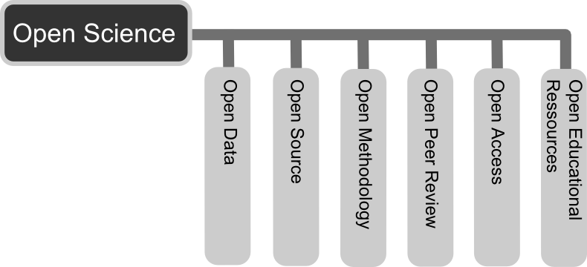
More than open access publishing
CC-BY Andreas Neuhold https://commons.wikimedia.org/wiki/File:Open_Science_-_Prinzipien.png

Slide 6

Open access to publications
Free, immediate, online access to the results of research
Free to reuse e.g. to build tools to mine the content
Two routes to make sure anyone can access your papers
Gold route: paying APCs to ensure publishers makes copy open
Green route: self-archiving Open Access copy in repository
Find out what your publisher allows on SHERPA RoMEO
www.sherpa.ac.uk/romeo

Slide 7
Open data
“Open data and content can be freely used, modified and shared by anyone for any purpose”
http://opendefinition.org
Tim Berners-Lee’s proposal for five star open data - http://5stardata.info
⬆ | make your stuff available on the Web (whatever format) under an open licence
⬆⬆ | make it available as structured data (e.g. Excel instead of a scan of a table)
⬆⬆⬆ | use non-proprietary formats (e.g. CSV instead of Excel)
⬆⬆⬆⬆ | use URIs to denote things, so that people can point at your stuff
⬆⬆⬆⬆⬆ | link your data to other data to provide context

Slide 8
Open methods
Documenting and sharing workflows and methods
Sharing code and tools to allow others to reproduce work
Using web based tools to facilitate collaboration and interaction from the outside world
Open netbook science – “when there is a URL to a laboratory notebook that is freely available and indexed on common search engines.”
http://drexel-coas-elearning.blogspot.co.uk/2006/09/open-notebook-science.html

Slide 9
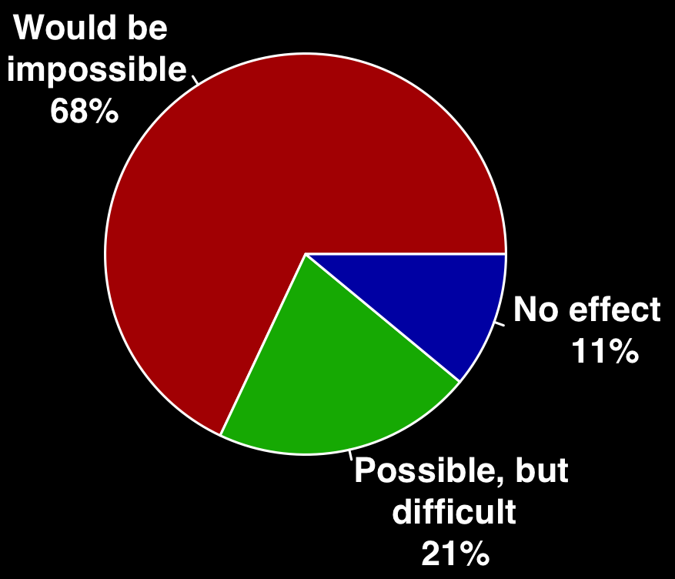
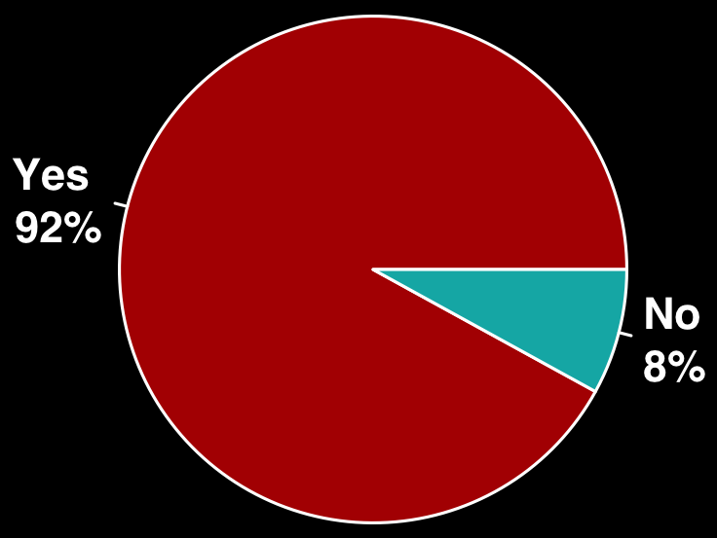
Reliance on specialist research software Slide from Neil Chue-Hong, Software Sustainability Institute
Do you use research software?
What would happen to your research without software
56%
Develop their own software
71%
Have no formal software training
Survey of researchers from 15 UK Russell Group universities conducted by SSI between August - October 2014. DOI: 10.5281/zenodo.14809
Notes:
In the last four years, we have investigated and understood the challenges of the UK research community.
Anecdotally, we had a lot of evidence for people working in this area that researchers relied on software, but there had been no studies conducted. So we did this ourselves.
Two areas of interest, do you use software and possibly more important, what would happen to your research without software – this is 170,000 researchers in the UK who could not conduct their software without software.
This is more than just a reliance on Word or web browsers – specialist software is written into the research workflows of people from psychology to physics, from the life sciences to literature. The reliance isn’t confined to the “traditionally” computationally intensive subjects, it’s a feature of all disciplines.
This means that 140,000 researchers are relying on their own coding skills.

Slide 10

Openness at every stage
Design
Experiment
Analysis
Publication
Release
Change the typical lifecycle
Publish earlier and release more
Papers + Data + Methods + Code…
Support reproducibility
Open science image CC BY-SA 3.0 by Greg Emmerich www.flickr.com/photos/gemmerich/6365692655

Slide 11




Degrees of openness
Five star open data
⬆⬆⬆⬆⬆
Unable to share
Under embargo
Open Restricted Closed
Limits on who can use the data, how or for what purpose
Charges for use
Data sharing agreements
Restrictive licences
Peer-to-peer exchange
…
Content that can be
freely used, modified and shared by anyone
for any purpose

Slide 12

Why Practice open science?
Benefits and drivers
Image CC-BY-NC-SA by wonderwebby www.flickr.com/photos/wonderwebby/2723279491

Slide 13
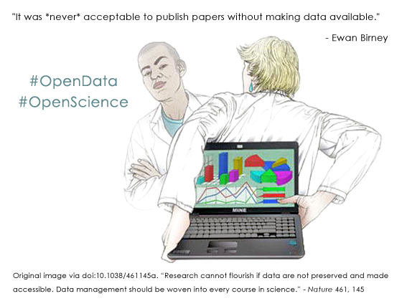
It’s part of good research practice

Slide 14
Some benefits of openness
Relevant literature is accessible – not behind pay walls
Ensures research is transparent and reproducible
Increased visibility, usage and impact of research
New collaborations and research partnerships
Ensure long-term access to the outputs of research
Help increase research efficiency

Slide 15
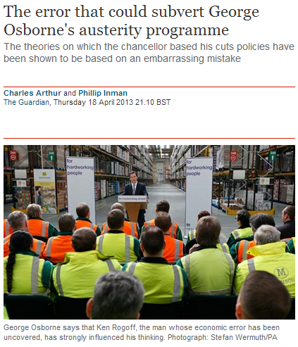
Validation of results
“It was a mistake in a spreadsheet that could have been easily overlooked: a few rows left out of an equation to average the values in a column.
The spreadsheet was used to draw the conclusion of an influential 2010 economics paper: that public debt of more than 90% of GDP slows down growth. This conclusion was later cited by the International Monetary Fund and the UK Treasury to justify programmes of austerity that have arguably led to riots, poverty and lost jobs.”
www.guardian.co.uk/politics/2013/apr/18/uncovered-error-george-osborne-austerity
Notes:
The validation of results is key. This article references an inadvertent error in a economics paper by Reinhadt and Rogoff. Missing some rows out of an average gave drastically different results – what was published suggested that countries with 90% debt ratios see their economies shrink by 0.1%. Instead, it should have found that they grow by 2.2% – less than those with lower debt ratios, but not a spiralling collapse. This mistake wasn’t picked up on initially as the data hadn’t been shared. The mistake fed into government policy - the findings of this paper were used as justification for austerity measures in the UK and various other countries in the EU.

Slide 16
Acceleration of the research process
“As more papers are deposited and more scientists use the repository, the time between an article being deposited and being cited has been shrinking dramatically, year upon year. This is important for research uptake and progress, because it means that in this area of research, where articles are made available at – or frequently before – publication, the research cycle is accelerating.”
Open Access: Why should we have it? Alma Swan www.keyperspectives.co.uk
Notes:
To look at things in a more positive light, this study shows how open access publishing accelerates the research process. It looks at citations rates for articles deposited in arXiv – a preprints repository in maths, physics, astronomy, computer science etc The time lag between deposit and citation of an article has been shrinking drastically year on year. Nowadays the research cycle in High-Energy Physics (HEP) is approaching maximum efficiency as a result of the early and free availability of articles that scientists in the field can use and build upon rapidly.

Slide 17
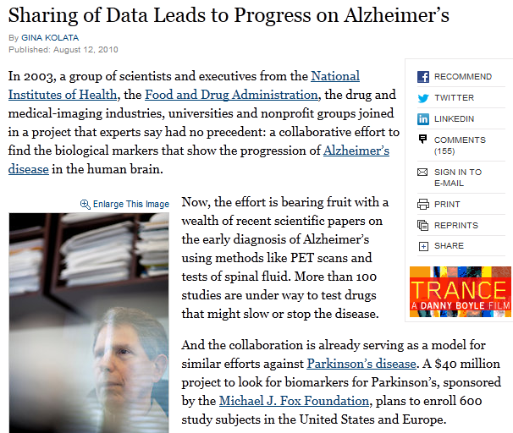
More scientific breakthroughs
“It was unbelievable. Its not science the way most of us have practiced in our careers. But we all realised that we would never get biomarkers unless all of us parked our egos and intellectual property noses outside the door and agreed that all of our data would be public immediately.”
Dr John Trojanowski, University of Pennsylvania
www.nytimes.com/2010/08/13/health/research/13alzheimer.html?pagewanted=all&_r=0
Notes:
Certain research communities have also seen the benefit of sharing data as it speeds up the process of discovery. This article shows how researchers in the field of Alzheimer’s research have agreed as a community to share data immediately to make scientific breakthroughs.

Slide 18

The Open Research Data Pilot
What is required and how to comply?

Slide 19
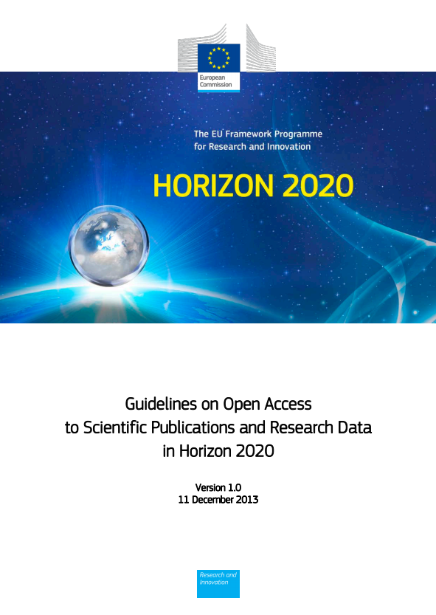
Funder imperatives...
“The European Commission’s vision is that information already paid for by the public purse should not be paid for again each time it is accessed or used, and that it should benefit European companies and citizens to the full.”
http://ec.europa.eu/research/participants/data/ ref/h2020/grants_manual/hi/oa_pilot/h2020-hi-oa-pilot-guide_en.pdf
Notes:
The background to this is about making the most of the data that has been created through publicly funded research. The guidelines speak of:
Improved quality of results
Greater efficiency
Faster to market = faster growth
Improved transparency of the scientific process
19

Slide 20
Open Research Data (ORD) Pilot
Pilot focuses on research data specifically
‘Research data’ refers to information, in particular facts or numbers, collected to be examined and considered as a basis for reasoning, discussion or calculation.
In a research context, examples of data include statistics, results of experiments, measurements, observations resulting from fieldwork, survey results, interview recordings and images. The focus is on research data that is available in digital form.
Guidelines on Open Access to Scientific Publications and Research Data in Horizon 2020 v.1.0, 11 December 2013, Footnote 5, p3

Slide 21
H2020 areas participating in the pilot
Future and Emerging Technologies
Research infrastructures (new: coverage of the whole area)
Leadership in enabling and industrial technologies – Information and Communication Technologies
Nanotechnologies, Advanced Materials, Advanced Manufacturing and Processing, and Biotechnology: ‘nanosafety’ and ‘modelling’ topics (new)
Societal Challenge: Food security, sustainable agriculture and forestry, marine and maritime and inland water research and the bioeconomy - selected topics as specified in the work programme (new)
Societal Challenge: 'Climate Action, Environment, Resource Efficiency and Raw materials' – except raw materials
Societal Challenge: 'Europe in a changing world – inclusive, innovative and reflective Societies'
Science with and for Society
Cross-cutting activities - focus areas – part Smart and Sustainable Cities (moved from Energy WP)
Projects in other areas can participate on a voluntary basis
Notes:
There are seven areas participating in the pilot. This corresponds to about €3 billion or 20% of the overall Horizon 2020 budget in 2014 and 2015.
Projects in others can take part on a voluntary basis. It’s an opt in / opt out basis.
21

Slide 22
Exemptions – reasons for opting out
If results are expected to be commercially or industrially exploited
If participation is incompatible with the need for confidentiality in connection with security issues
Incompatible with existing rules on the protection of personal data
Would jeopardise the achievement of the main aim of the action
If the project will not generate / collect any research data
If there are other legitimate reasons to not take part in the Pilot
Can opt out at proposal stage OR during lifetime of project
Should describe issues in the project Data Management Plan
Notes:
Projects in these seven areas aren’t forced to participate. There are various reasons to opt out e.g. if results can’t be shared due to confidentiality, legal restrictions or commercial opportunities.
Opt out is available at any point. It can also apply to certain parts of the data e.g. they could share some aspects but not others.
22

Slide 23

Approach:
as open as possible, as closed as necessary
Image: ‘Balancing rocks’ by Viewminder CC-BY-SA-ND www.flickr.com/photos/light_seeker/7780857224

Slide 24
Which data does the pilot apply to?
Data, including associated metadata, needed to validate the results in scientific publications
Other curated and/or raw data, including associated metadata, as specified in the DMP
Doesn’t apply to all data (researchers to define as appropriate)
Don’t have to share data if inappropriate – exemptions apply
Notes:
For those that do take part in the pilot, the starting point is to make all data that underpin publications open. After that, it’s for researchers to define what else should be shared and can be made open. This should be outlined in the DMP.
Sometimes sharing is not appropriate (e.g. due to ethical rules of personal data, intellectual property protection, commercial restrictions etc). It’s fine to apply restrictions in such cases. This could be an embargo period prior to publication or while a patent is sought, or controlling access and re-use to protect participants’ identities (e.g. via the use of secure data services / data enclaves or data sharing agreements). Restrictions should be outlined up-front in the DMP.
24

Slide 25
Key requirements of the open data pilot
Beneficiaries participating in the Pilot will:
Deposit data in a research data repository of their choice
Take measures to make it possible for others to access, mine, exploit, reproduce and disseminate the data free of charge
Provide information about tools and instruments necessary for validating the results (where possible, provide the tools and instruments themselves)
Notes:
So the specific requirements on projects that participate in the pilot are to:
- Deposit data in a repository
Enable reuse via open licensing
Provide any tools (or at least info on them) needed to validate the data
The focus is planning for data sharing and then facilitating that through deposit, licensing and enabling reproducibility
25

Slide 26
Data Management Plans
Projects participating in the pilot will be required to develop a Data Management plan (DMP), in which they will specify what data will be open.
Note that the Commission does NOT require applicants to submit a DMP at the proposal stage.
A DMP is therefore NOT part of the evaluation.
DMPs are a deliverable for those participating in the pilot.
Notes:
26

Slide 27
Info on RDM: what and when
PROPOSAL STAGE
IN PROJECT
Where relevant*, H2020 proposals can include a section on data management which is evaluated under the criterion ‘Impact’
What types of data will the project generate/collect?
What standards will be used?
How will this data be shared/made available? If not, why?
How will this data be curated and preserved?
* For “Research and Innovation actions” and “Innovation Actions”
DMPs are a project deliverable for those participating in the open data pilot.
Not a fixed document – should evolve and gain precision
Deliver first version within initial 6 months of project
More elaborate versions whenever important changes to the project occur. At least at the mid-term and final review.
Notes:
Although DMPs are a project deliverable and not required at the application stage, proposals can include a section on data management if desired. The info suggested here is similar to the preliminary DMP, so essentially gets that started.
27

Slide 28
Initial DMP (at 6 months)
The DMP should address the points below on a dataset by dataset basis:
Data set reference and name
Identifier for the data set to be produced
Data set description
Description, origin and scale of the data that will be generated or collected, and to whom it could be useful
Information on the existence (or not) of similar data and the possibilities for integration and reuse
Standards and metadata
Reference to existing suitable standards of the discipline. If these do not exist, an outline of how and what metadata will be created.
Data sharing
How the data will be shared - widely open or restricted to specific groups – or reasons why it cannot be shared
Access procedures, embargo periods (if any), and technical mechanisms for dissemination
Software and other tools necessary for re-use
Repository where data will be stored
Archiving and preservation (including storage and backup)
Procedures for long-term preservation
How long the data should be preserved
Final data volume
How associated costs will be covered
Notes:
This template should be filled in for each dataset
28

Slide 29
More elaborate DMP
Scientific research data should be easily:
1. Discoverable
Are the data and software discoverable and identifiable by a standard mechanism e.g. DOIs?
2. Accessible
Are the data accessible and under what conditions e.g. licenses, embargoes etc?
3. Assessable and intelligible
Are the data and software assessable and intelligible to third parties for peer-review? E.g. can judgements be made about their reliability and the competence of those who created them?
4. Useable beyond the original purpose for which it was collected
Are the data properly curated and stored together with the minimum software and documentation to be useful by third parties in the long-term?
5. Interoperable to specific quality standards
Are the data and software interoperable, allowing data exchange? E.g. were common formats and standards for metadata used?
Notes:
The second template is provided based on the G8 principles and focuses on the qualities/properties needed. These are that scientific research data should be easily discoverable, accessible, assessable and intelligible, usable beyond the original purpose for which it was created, and interoperable to specific quality standards.
29

Slide 30
Guidelines from the Commission
Factsheet on Open Access
https://ec.europa.eu/programmes/horizon2020/sites/horizon2020/files/FactSheet_Open_Access.pdf
Guidelines on Open Access to Scientific Publications and Research Data in Horizon 2020
http://ec.europa.eu/research/participants/data/ref/h2020/grants_manual/hi/oa_pilot/h2020-hi-oa-pilot-guide_en.pdf
Guidelines on Data Management in Horizon 2020
http://ec.europa.eu/research/participants/data/ref/h2020/grants_manual/hi/oa_pilot/h2020-hi-oa-data-mgt_en.pdf

Slide 31

Thanks for listening
DCC resources:
www.dcc.ac.uk/resources
Follow us on twitter:
@digitalcuration and #ukdcc
Acknowledgement: many thanks to Birgit Schmidt for the details on the EC’s open access requirements, courtesy of the FOSTER project

